Slide 2

Ranga Rao Karanam
Founder, in28minutes

Slide 3
Why are Cloud Certifications Important?
Ranga Karanam – Founder – in28minutes

Slide 4


Slide 5


Slide 6
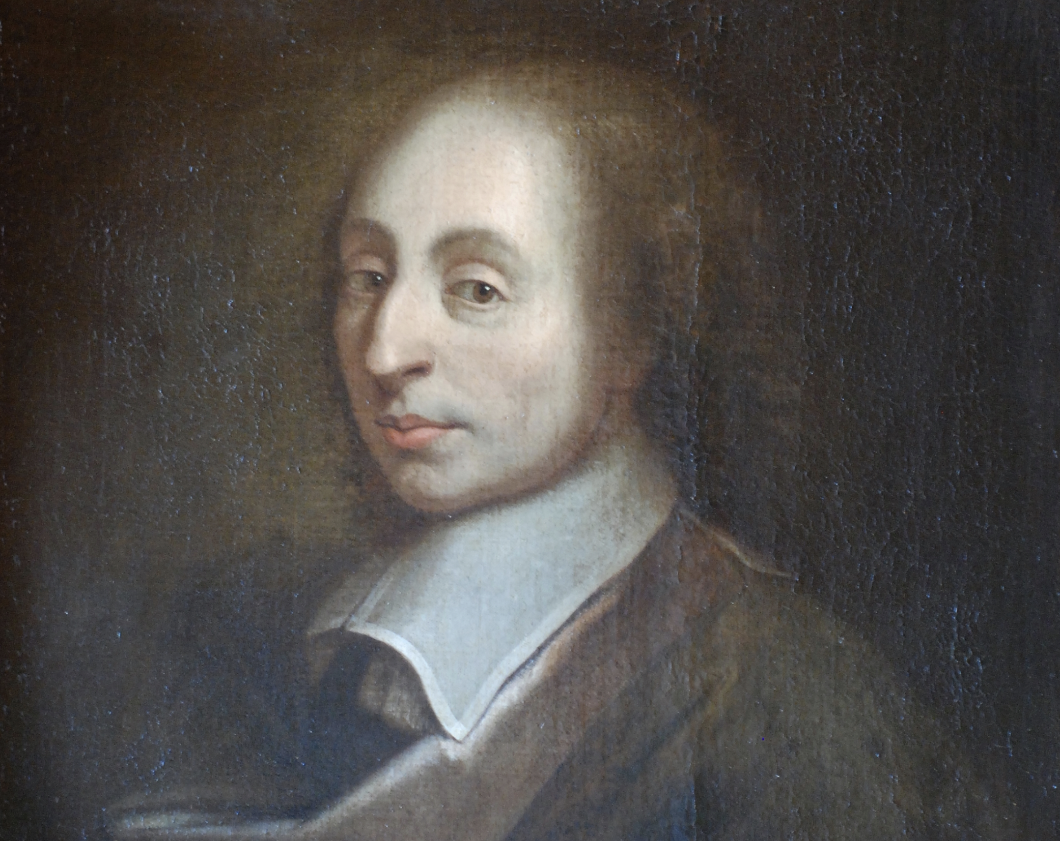

Slide 7
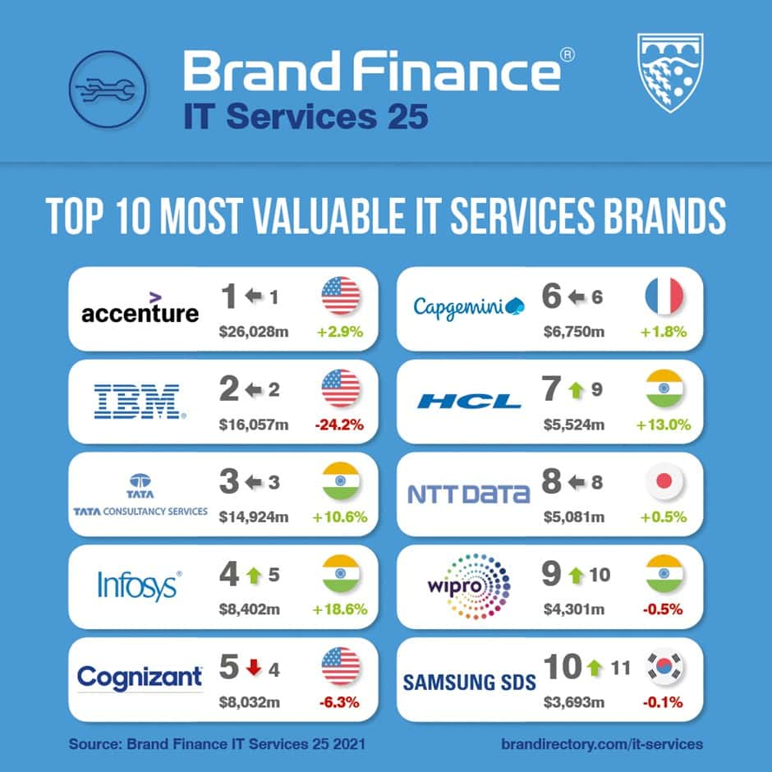
Notes:
- Worked from Chennai for 10 years
- IT services!

Slide 8
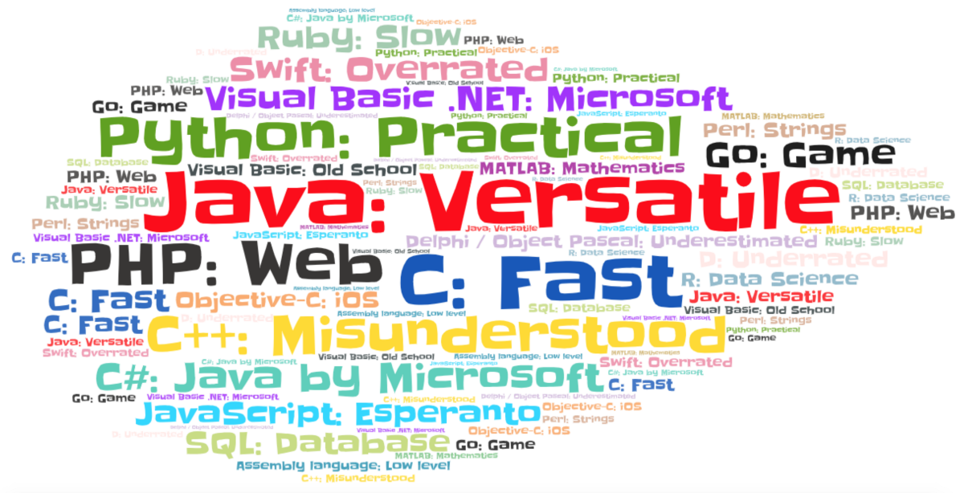

Slide 9


Slide 10


Slide 11


Slide 12
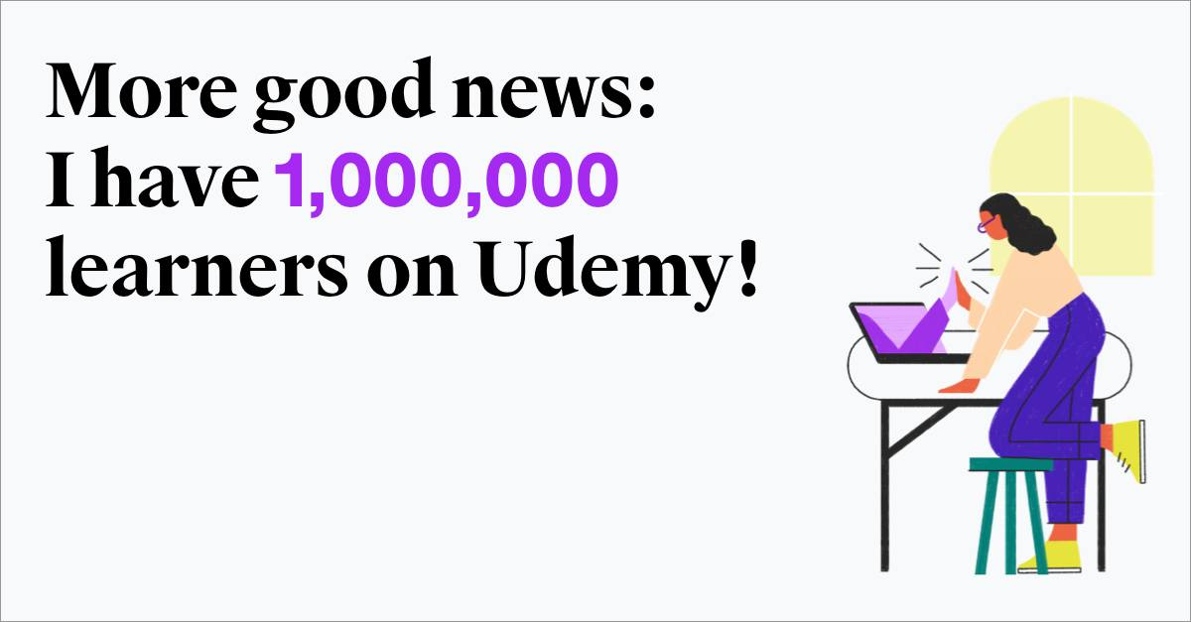

Slide 13


Slide 14
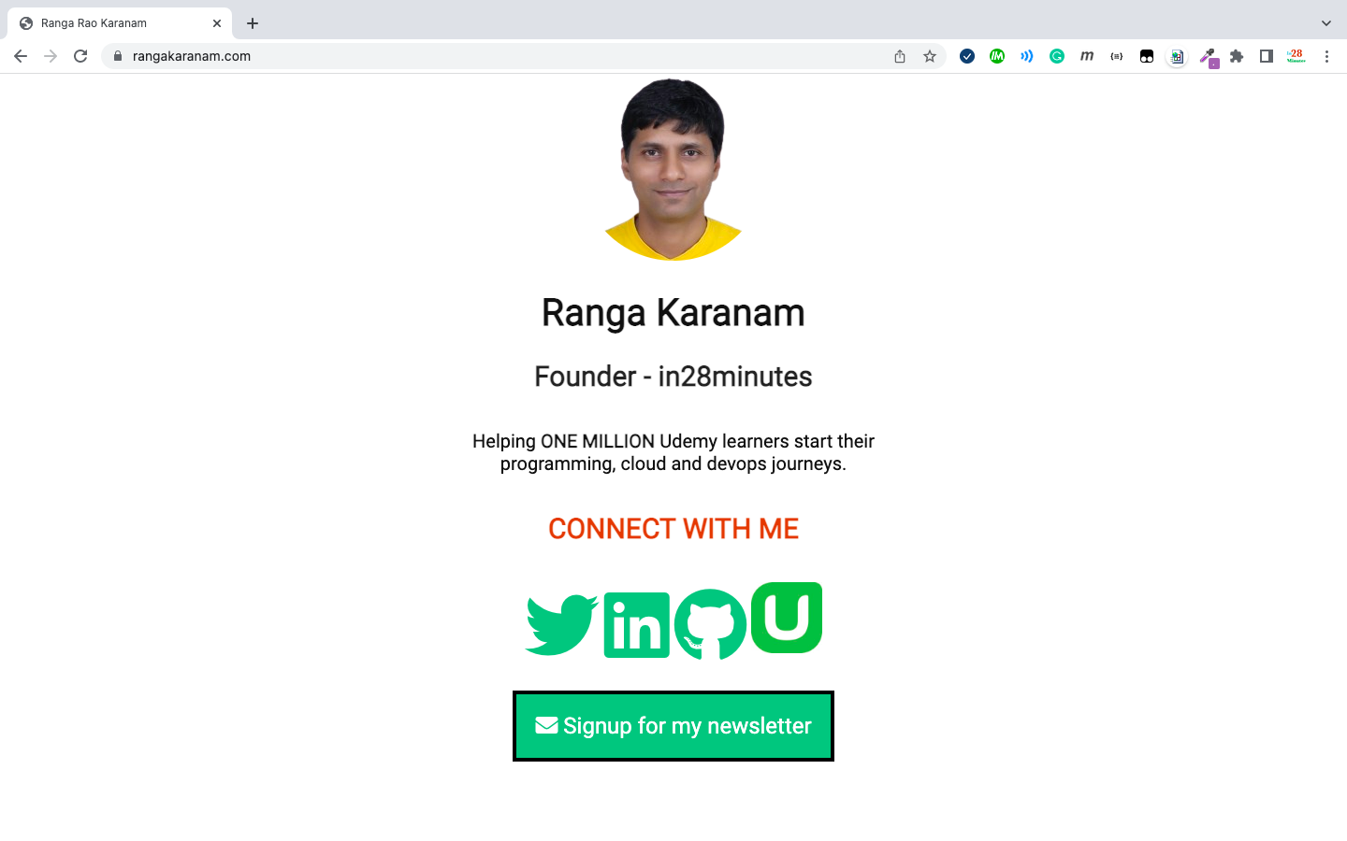

Slide 15
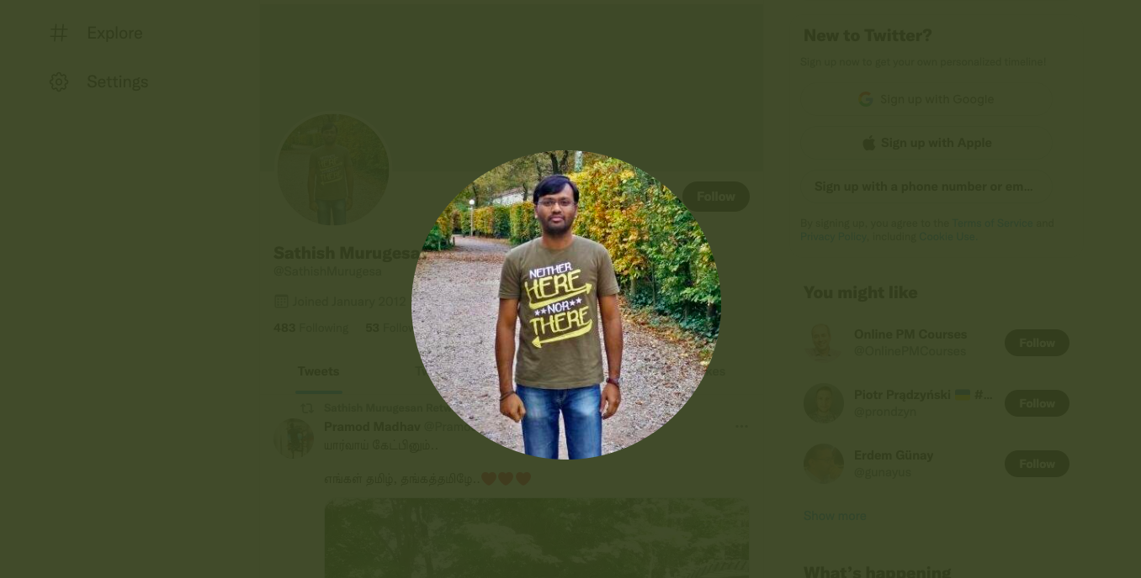

Slide 16
My Certification Journey
Cloud and otherwise

Slide 17
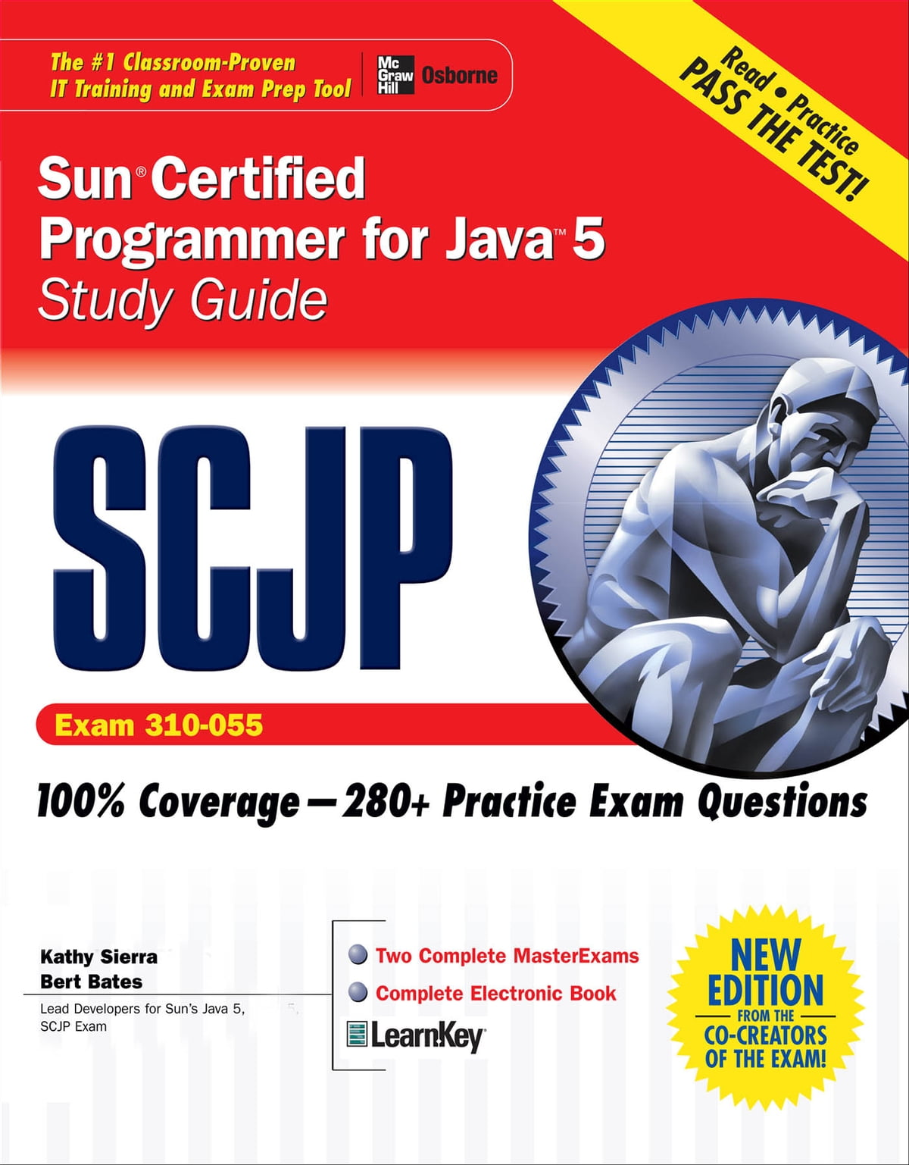

Slide 18
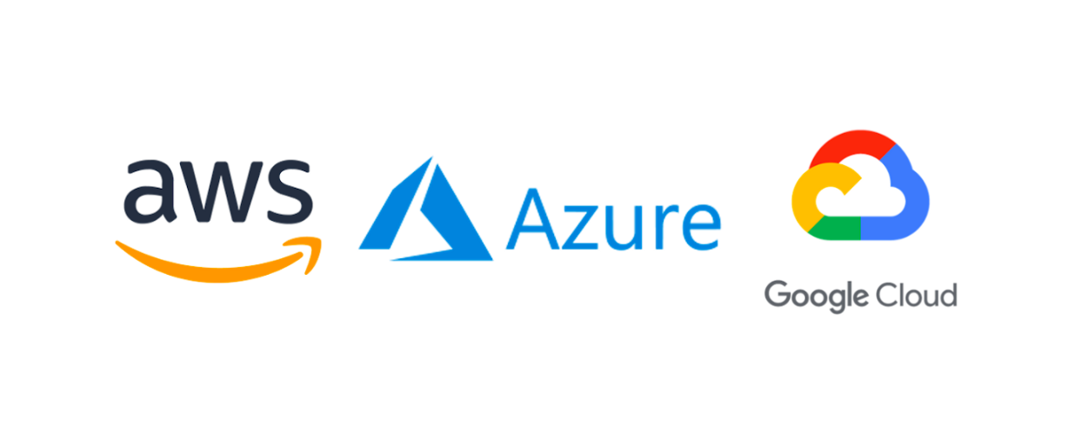
Notes:
NOW - 10x cloud certified

Slide 19

Notes:
What's the journey?

Slide 20

Notes:
Why the change?

Slide 21
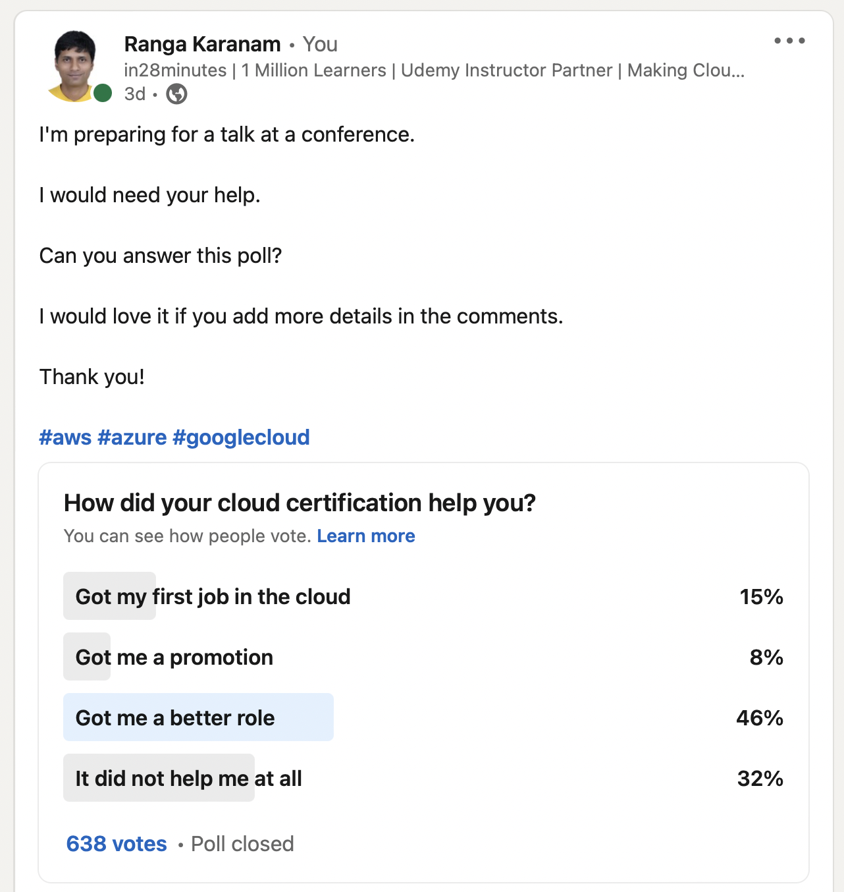
Notes:
Quick glance of results from survey: What are learners experiencing?

Slide 22
Why is Cloud Important?

Slide 23
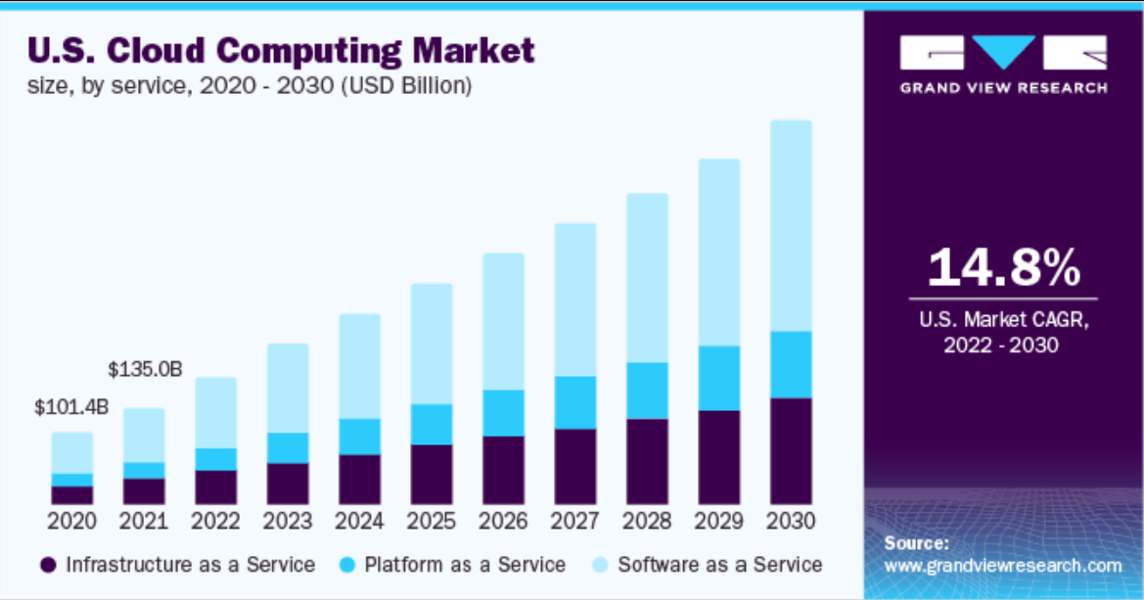
Notes:
Almost every enterprise out there is adopting the cloud

Slide 24
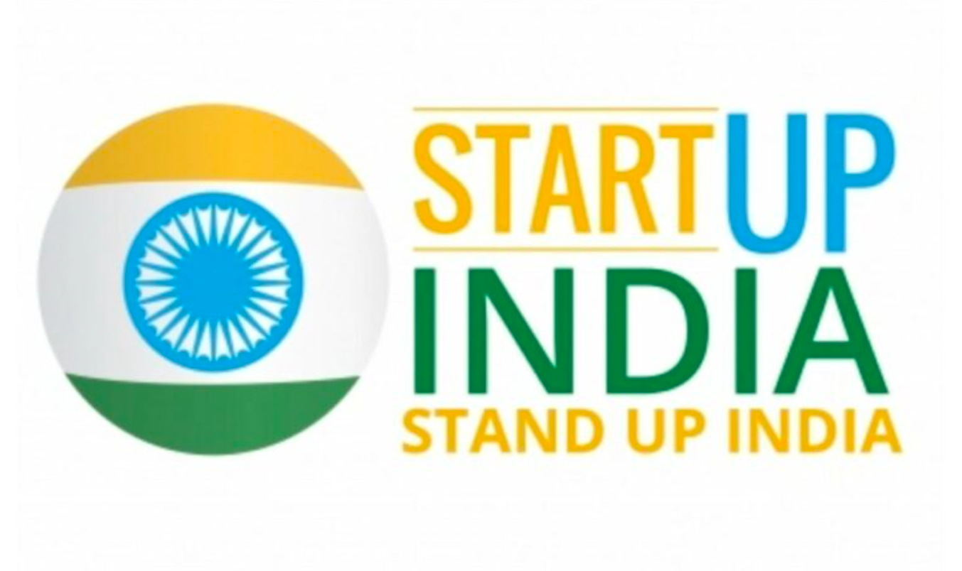
Notes:
- Cloud gives startups wings to fly (SaaS startups in India are booming)
- Almost every unicorn out there is making use of the cloud

Slide 25
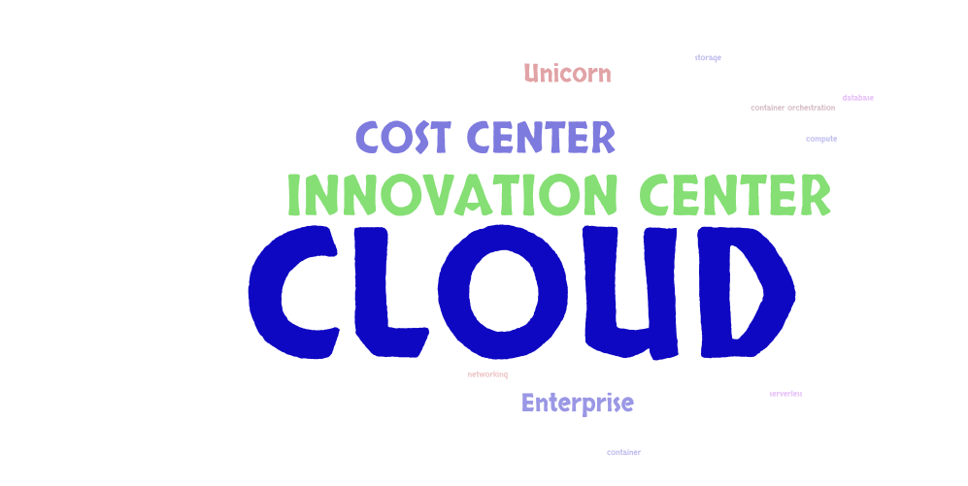
Notes:
- 1: Cloud started off as a cost center
- 2: Today it's the innovation center
- Adopting new technology/process becomes easier on the cloud

Slide 26
What is the Problem?

Slide 27
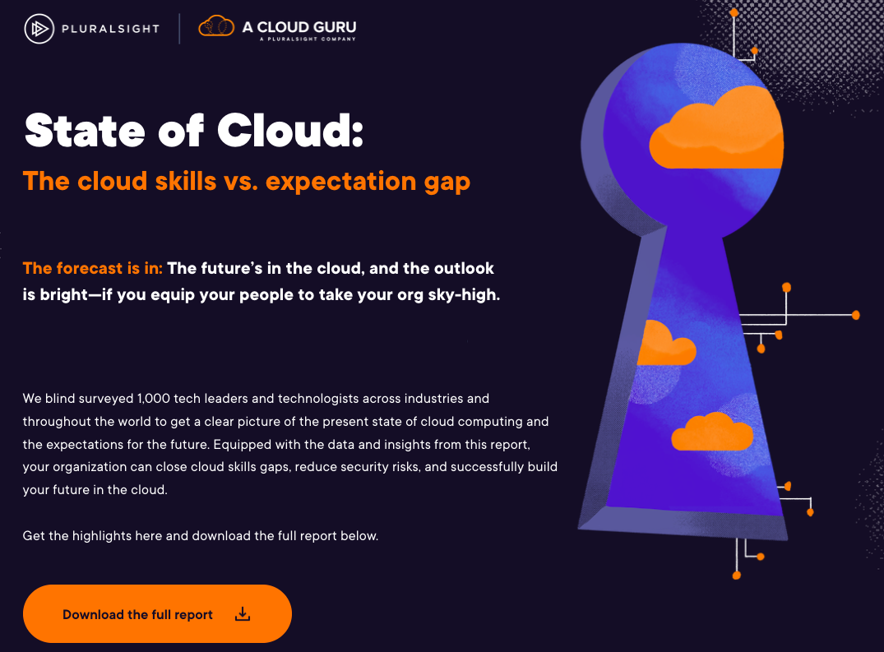
2022 State of Cloud Report - Pluralsight
Notes:
- Exponential growth in usage of cloud
- HOWEVER skills have not caught up

Slide 28
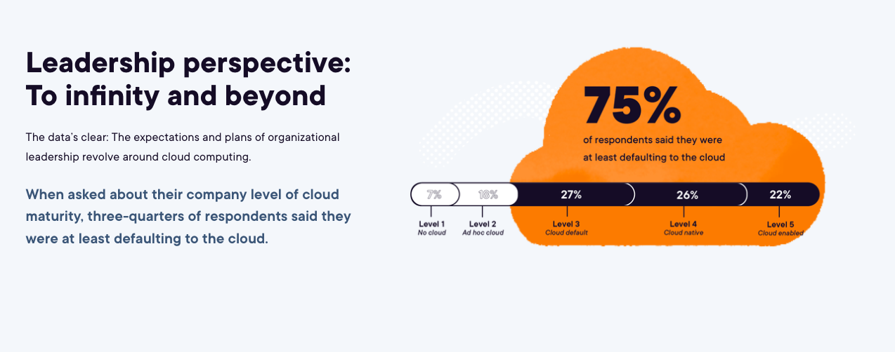
2022 State of Cloud Report - Pluralsight

Slide 29
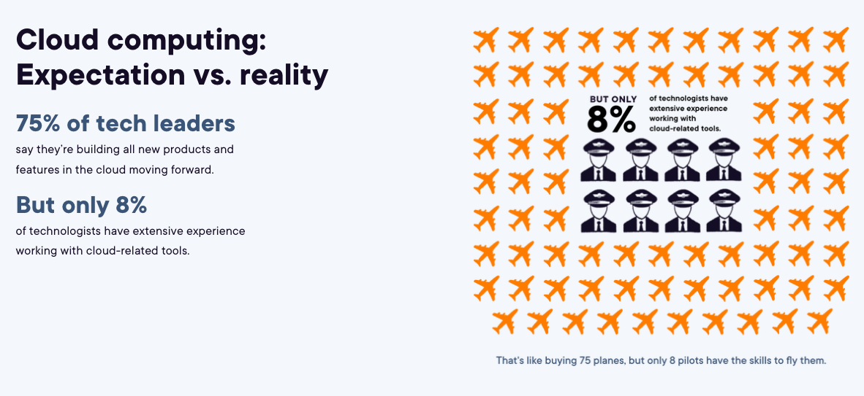
2022 State of Cloud Report - Pluralsight

Slide 30
Why are we lacking Cloud Skills?

Slide 31
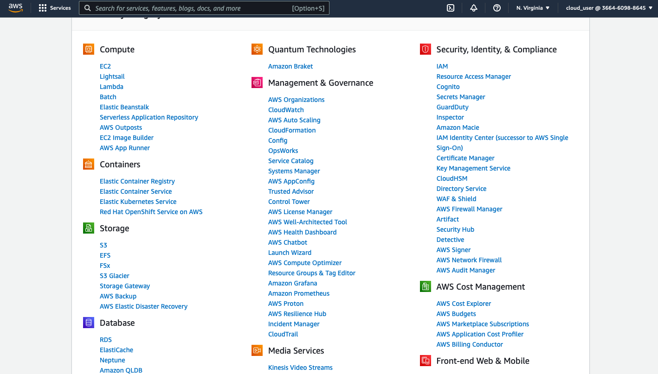
Notes:
1: Cloud is vast
Each cloud platform has 200+ services under different categories
- Screenshot: AWS services
- Screenshot: Azure services
- Screenshot: Google Cloud Services

Slide 32
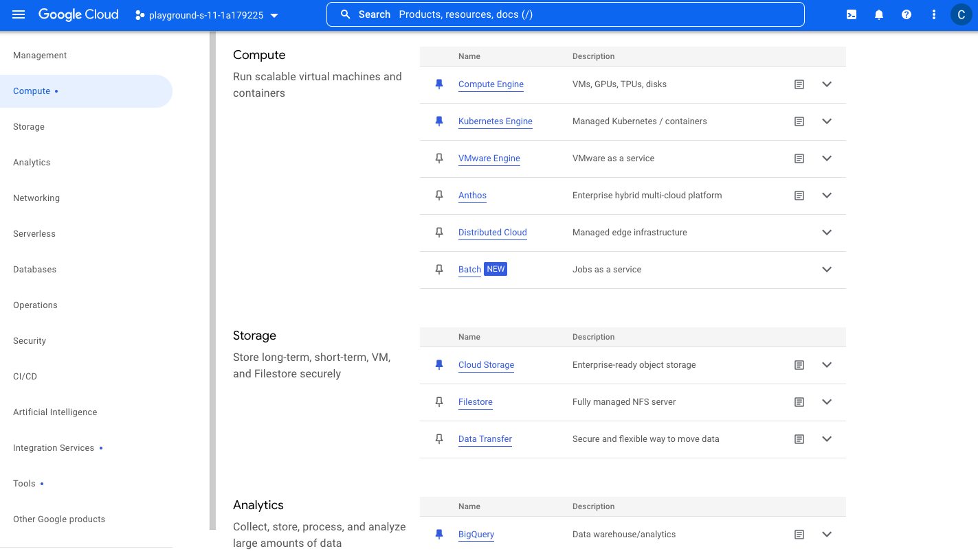

Slide 33
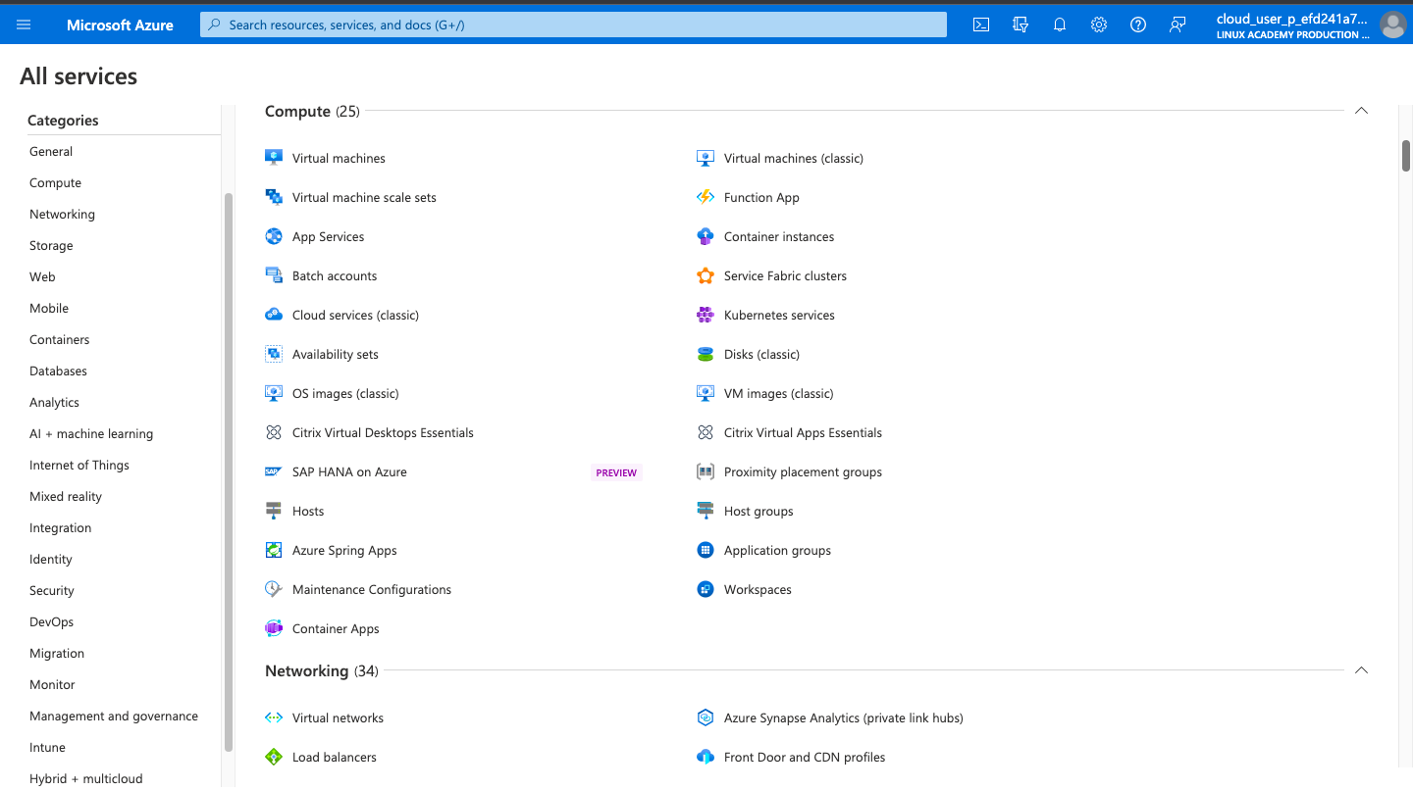

Slide 34
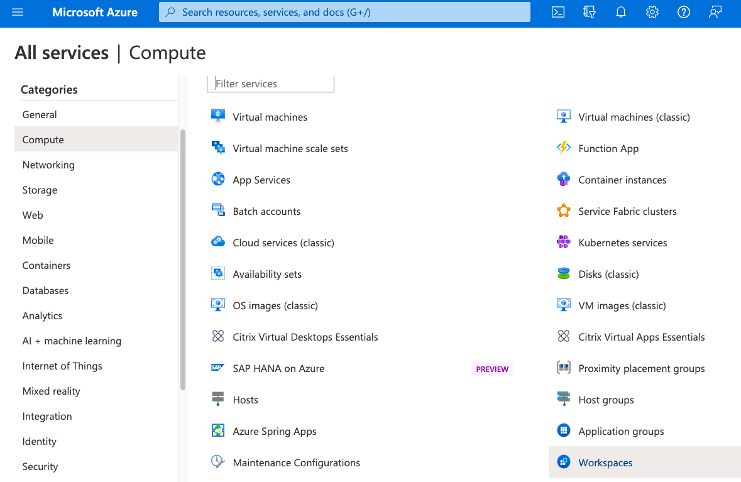

Slide 35
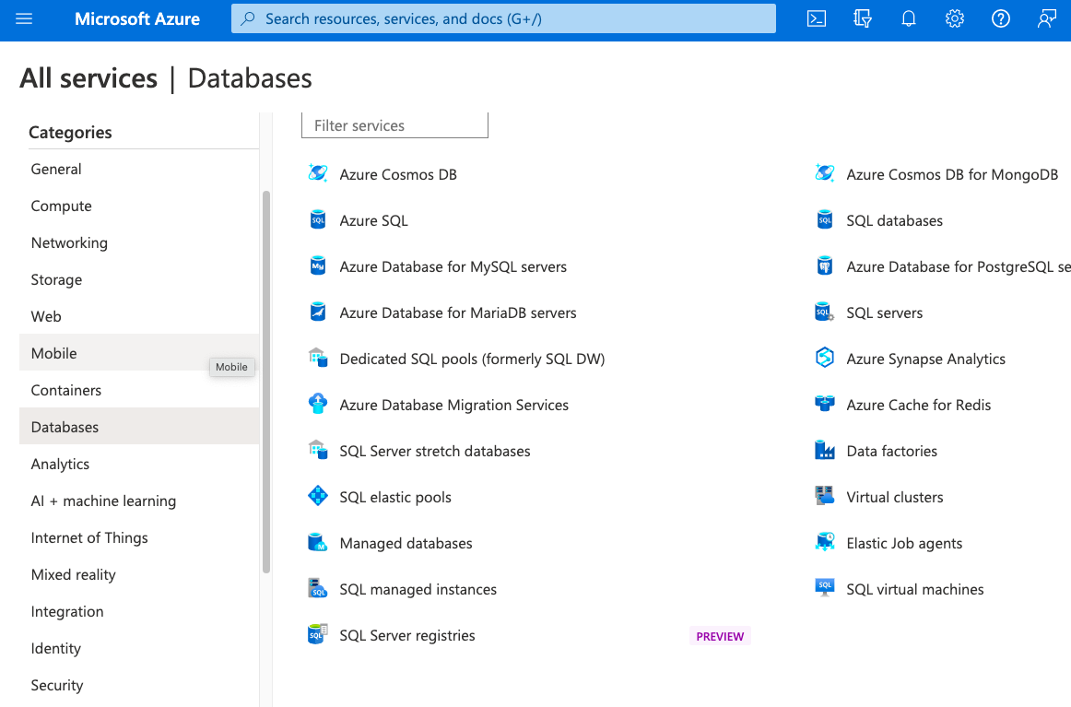

Slide 36
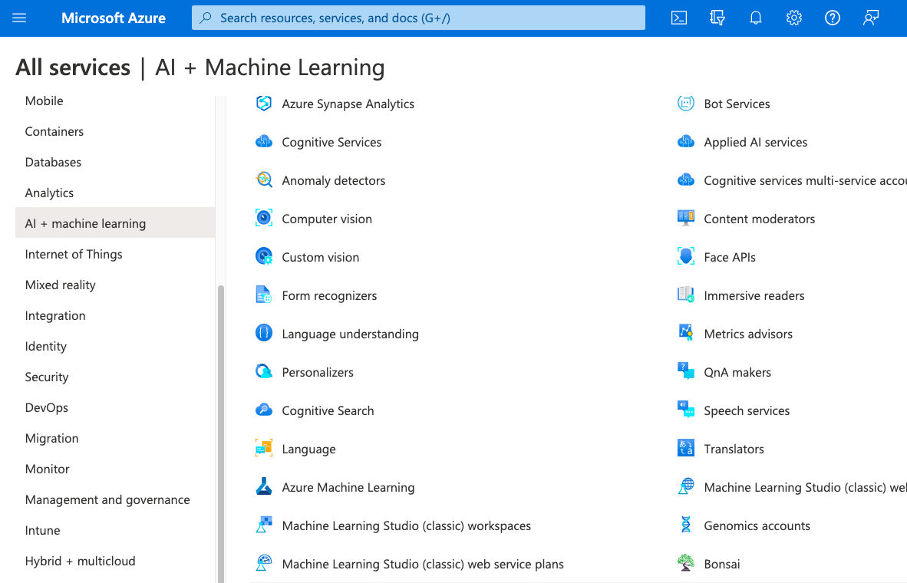

Slide 37
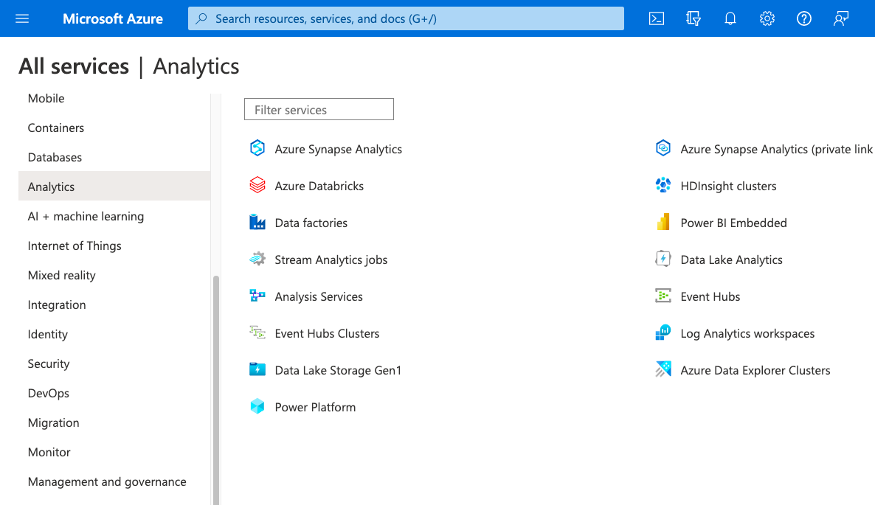

Slide 38
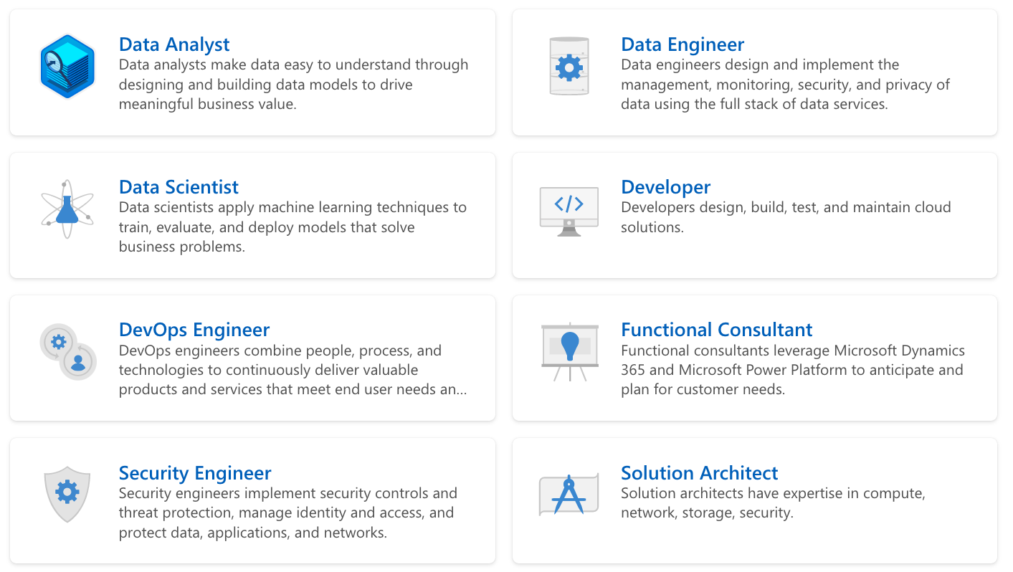
Notes:
- Each cloud role is different
- DevOps Engineer
- Full Stack Cloud Developer
- Machine Learning Specialist
- Data Engineers
- Different learners have different needs
- Managers and Sales Teams
- Experienced
- Beginning Programmers
- Operations Teams

Slide 39
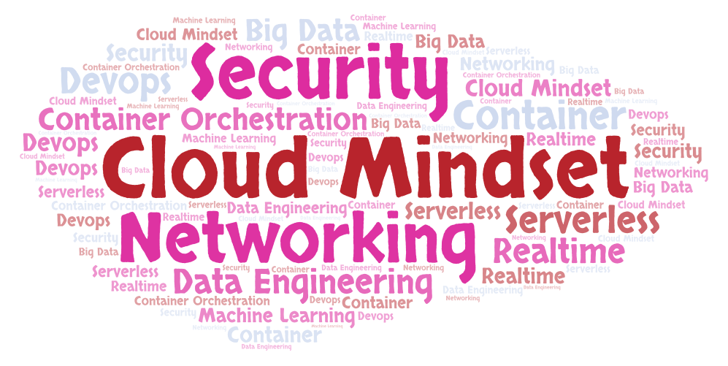
Notes:
- 2: Cloud needs a different mindset!
- Networking importance++
- Security importance++
- Understanding Terminology and Tech Evolution
- Serverless, Containers, Container Orchestration, DevOps, Big Data, Data Lakes, Data warehouses, Machine Learning
- Cloud platforms are innovating continuously
- Serverless, Container Orchestration, DevOps, Big Data, Machine Learning, IOT, ..
- In a few years, everything will be realtime (No Batch)

Slide 40
What’s the solution?

Slide 41
I would love to know!
Notes:
- I would love to say there is an easy solution but there is none!

Slide 42
Are certifications the solution?

Slide 43
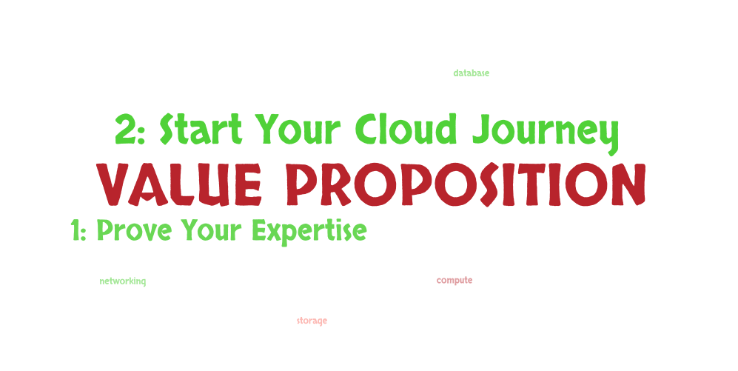
Notes:
- Two angles to look at the value proposition of certifications:
- 1: Prove your expertise gained over 3 years of working with a cloud platform
- PROBLEM: Not a lot of people exist with 3 years of experience in the cloud
- 2: Start learning cloud using certifications as a milestone

Slide 44
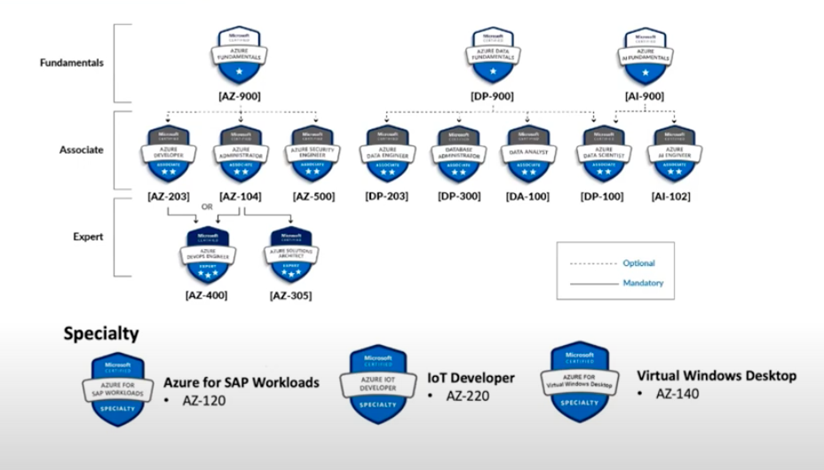
Eshant Garg – Udemy Instructor
Notes:
Detour: What is the Certification Path in Azure
TWO THINGS TO HIGHLIGHT
1: Best Organized Certifications among all cloud platforms
2: Best Fundamental Certifications among all cloud platforms
Matches with my thoughts for future: At least 50% of Data Engineering and AM/ML roles would be performed by Non Programmers in 5 years!

Slide 45
Notes:
Similar paths exist in other cloud platforms

Slide 46
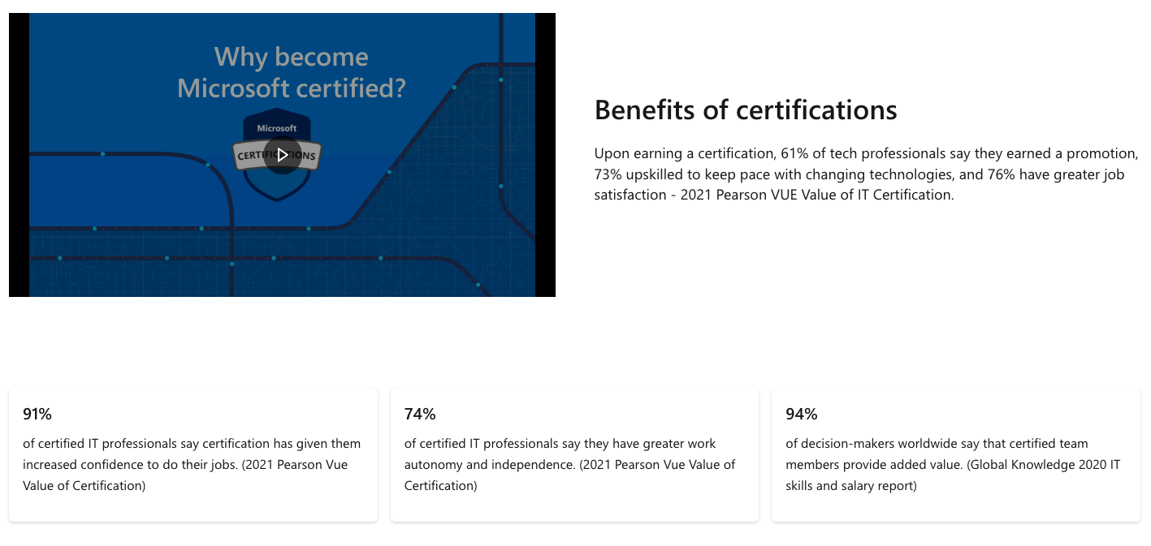
Microsoft Website – Oct 2022

Slide 48
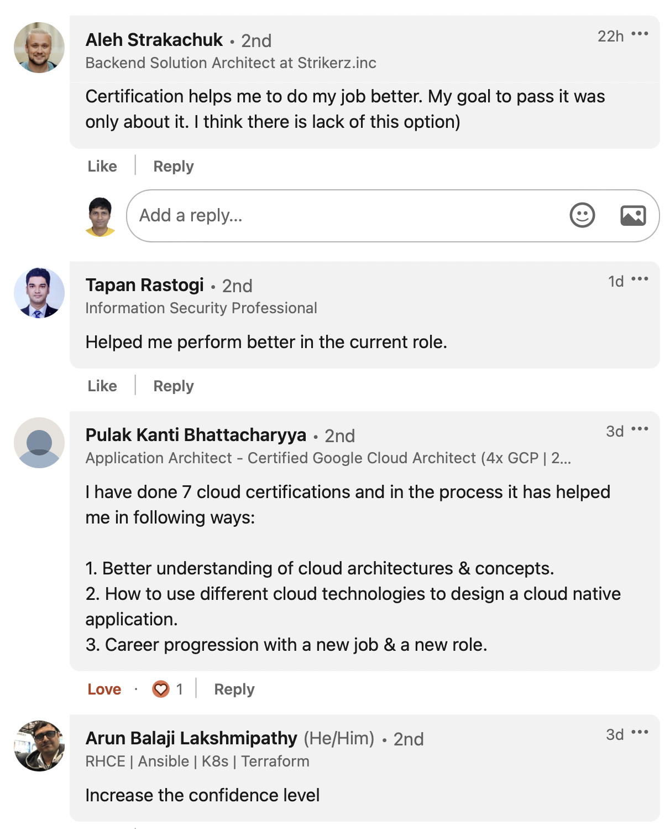

Slide 49
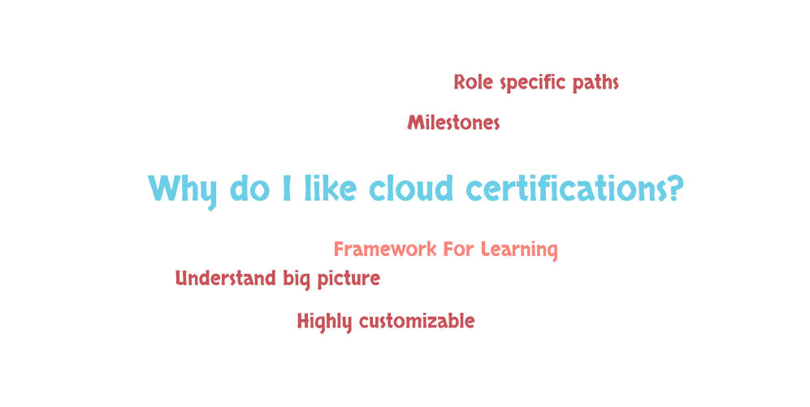
Notes:
- Give you a framework to anchor your learning
- Act as milestones
- Understand big picture
- Not everyone has the same needs - A REST API programmer can do an AI-900 certification to understand how to leverage pre-built AI solutions in his application
- Role specific paths
- Can be customized based on your experience

Slide 50
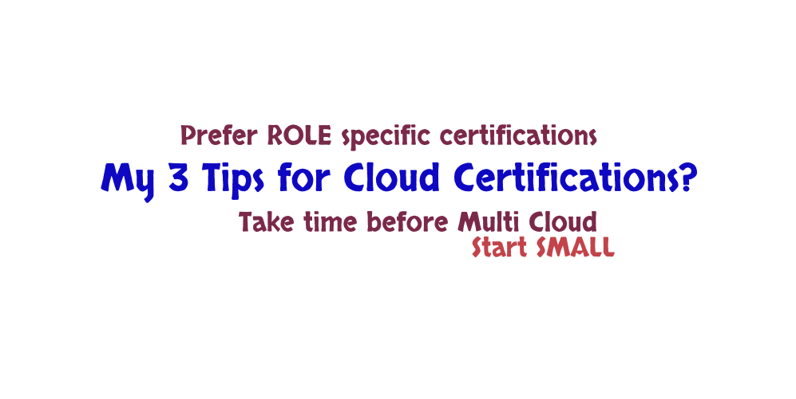
Notes:
- Start SMALL - Start with the basic certification if you have zero experience with the cloud - Cloud Digital Leader or AZ-900/DP-900/AI-900 or Cloud Practitioner
- Prefer ROLE specific certifications - Aim for a role specific certification if you have experience performing a specific role - Architect or Developer or Database or ML or Security or Networking ..
- Avoid Architect Certifications if you do NOT have sufficient design and architecture experience
- Do NOT Go For Multi Cloud Certifications unless you have a couple of years of experience with your first cloud

Slide 51
How can you get Cloud Certified?
Notes:
Basic Certs
NOT expensive
NOT difficult
Some of these are even FREE!

Slide 52
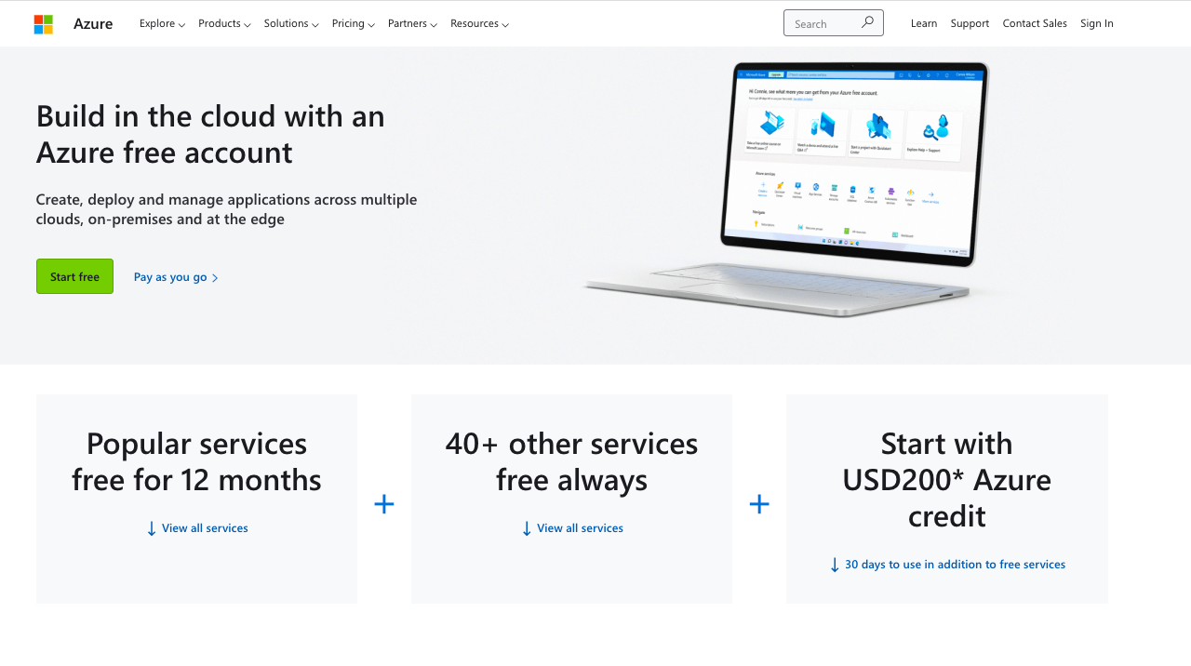

Slide 53
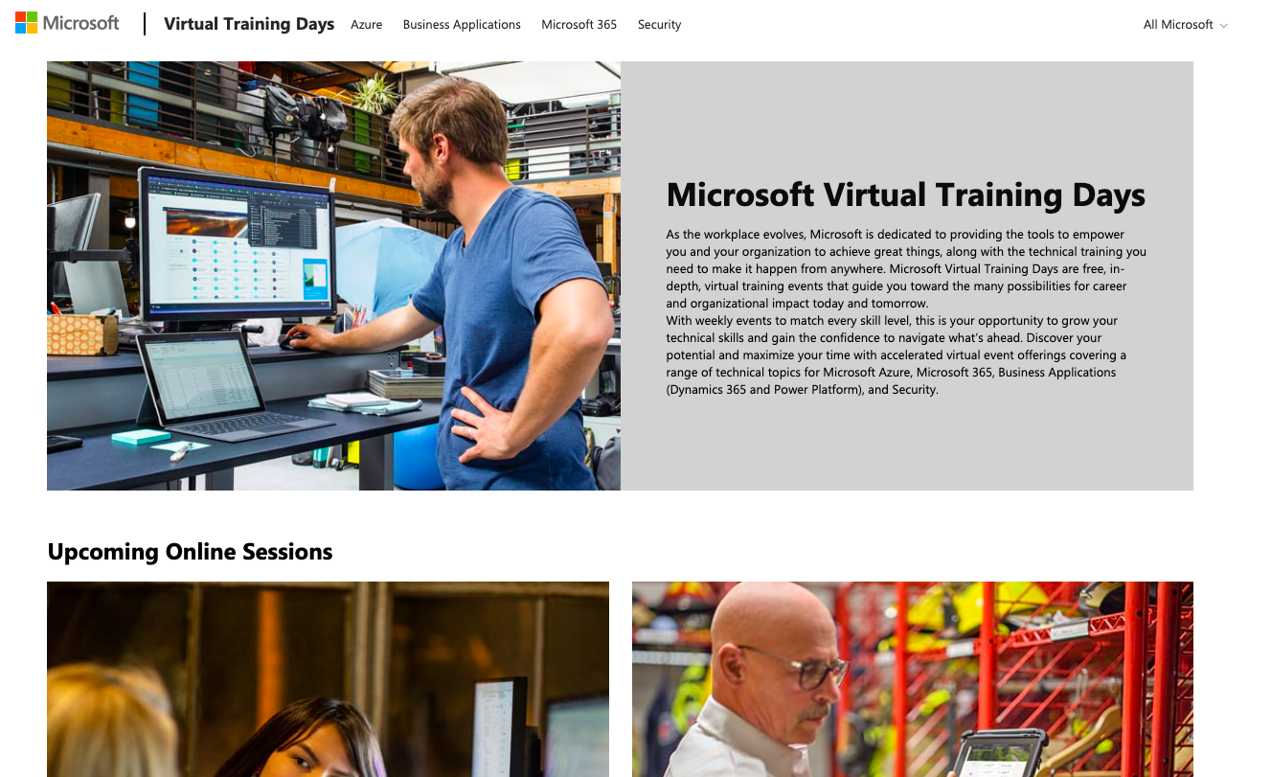

Slide 54
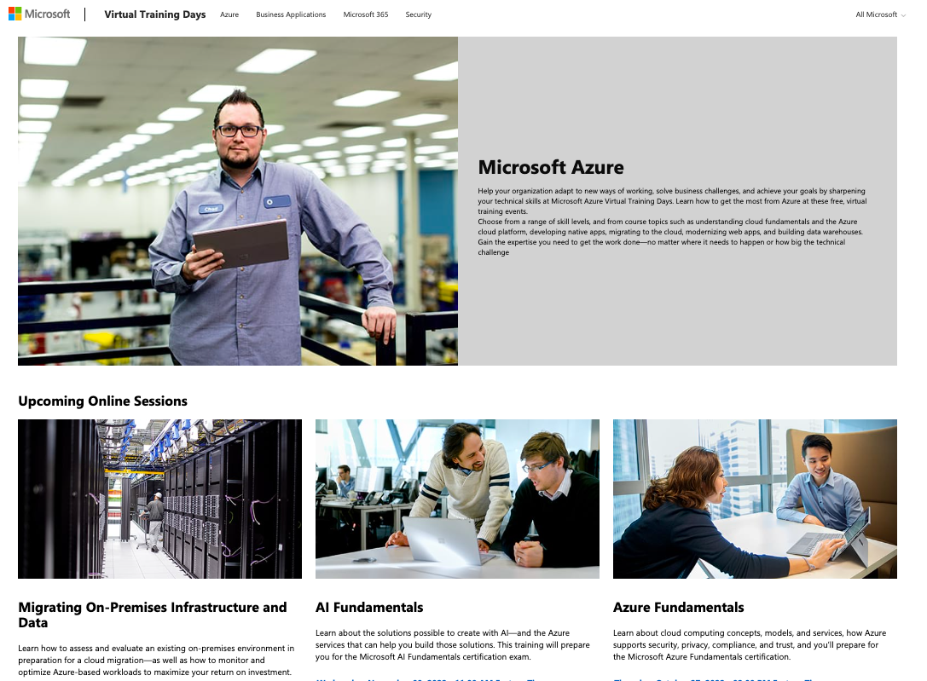

Slide 55
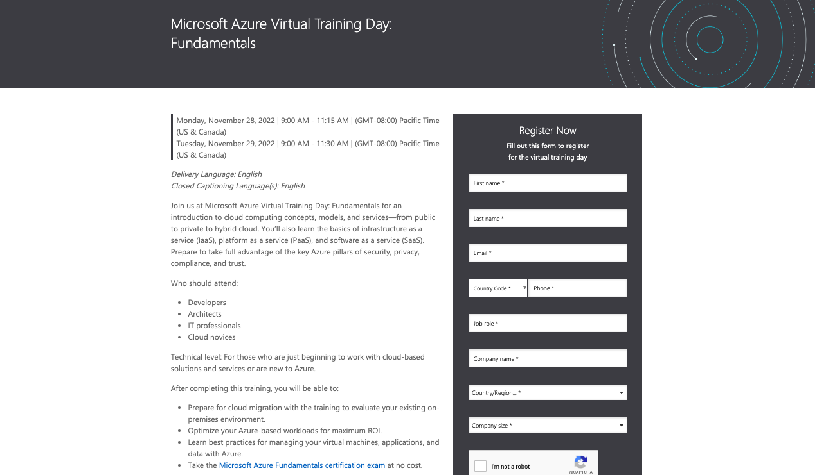

Slide 56
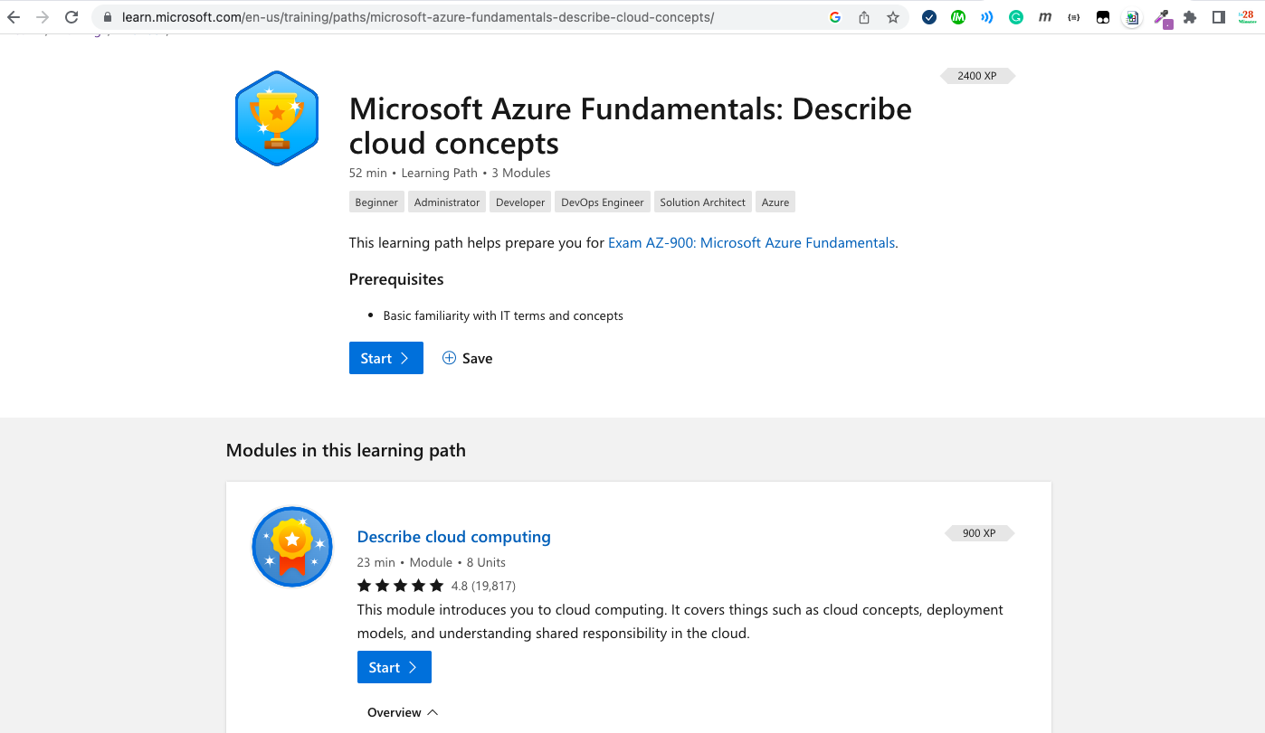

Slide 57


Slide 58
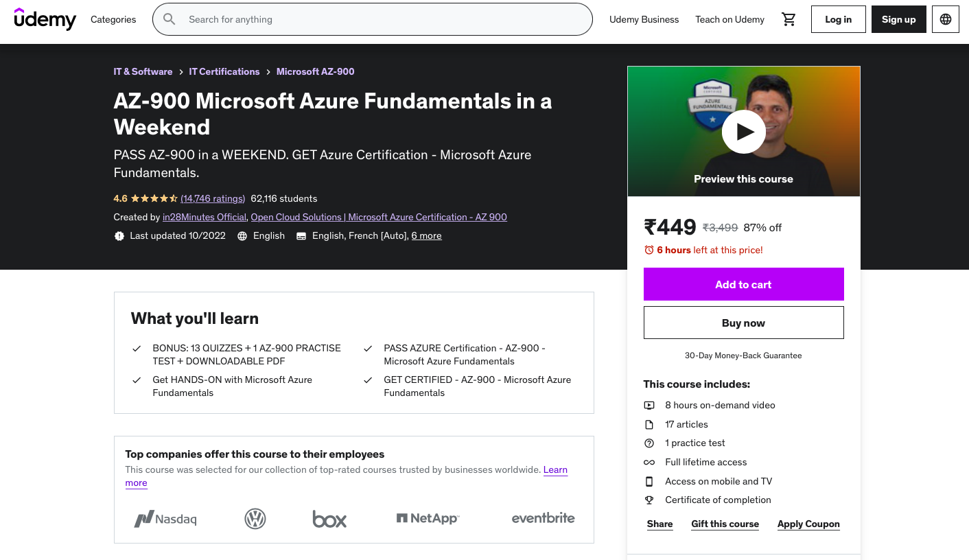

Slide 59
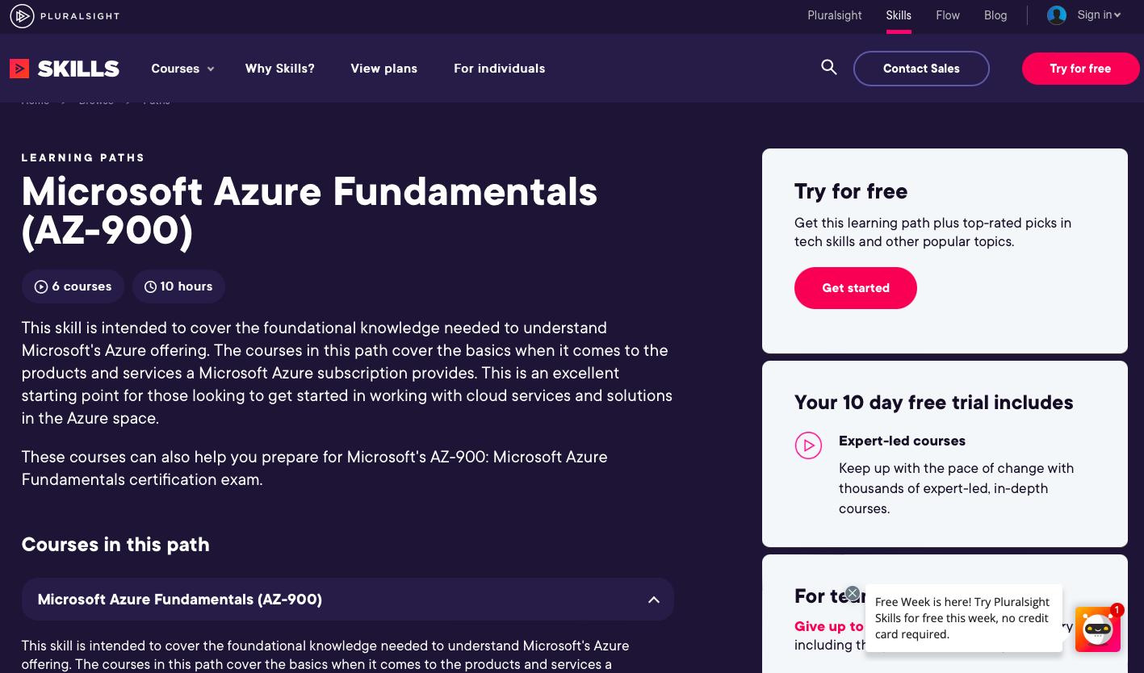

Slide 60
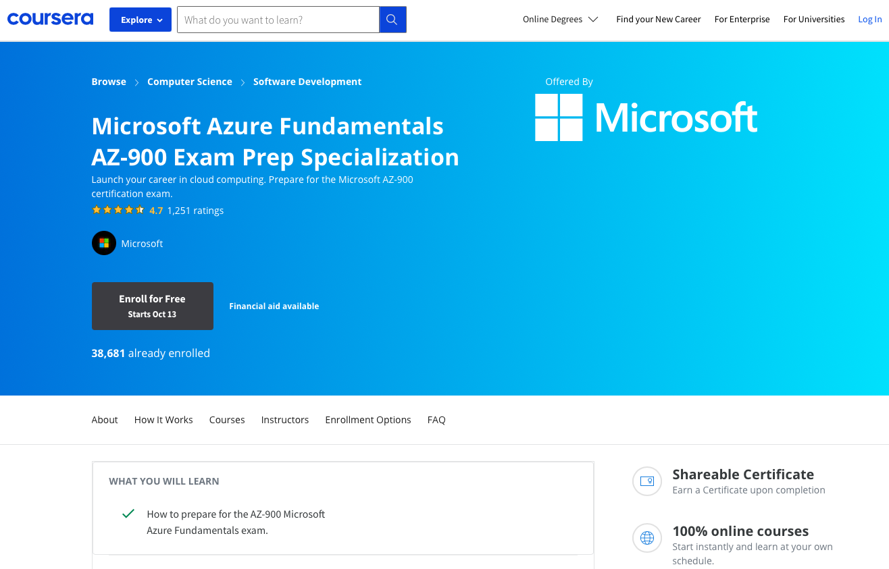

Slide 61
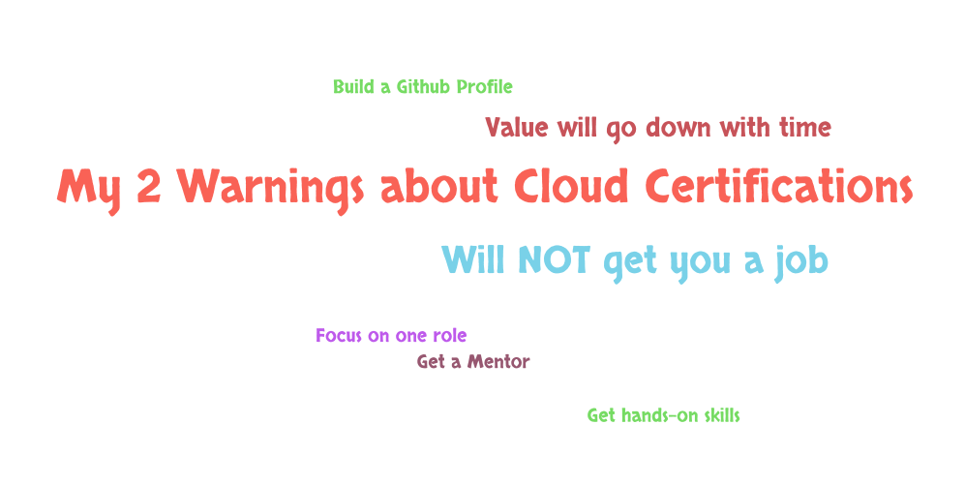
Notes:
- 1: Cloud certification will NOT get you a job
- Cloud Certifications help you get started!
- MY 4 RECOMMENDATIONS
- Focus on one role
- Get a Mentor
- Get hands-on skills
- Build a Github Profile
- 2: Value of cloud certifications is going to go down with time

Slide 62
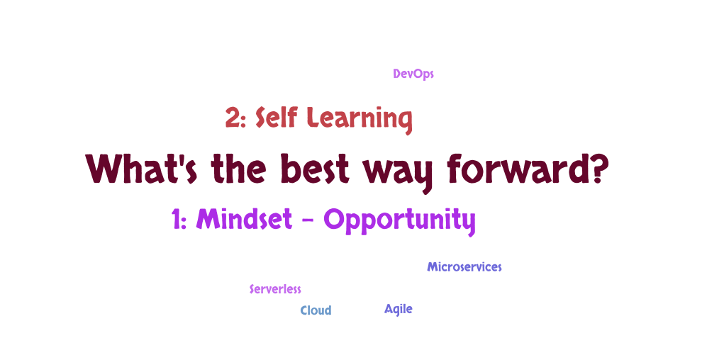
Notes:
- How do the best technology folks think?
- A: Technology is evolving continuously. Change is an opportunity BUT not a threat
- Needs a mindset where you see technology changes as an opportunity
- B: Most important differentiating SKILL today
- Are you able to learn on your own?

Slide 63
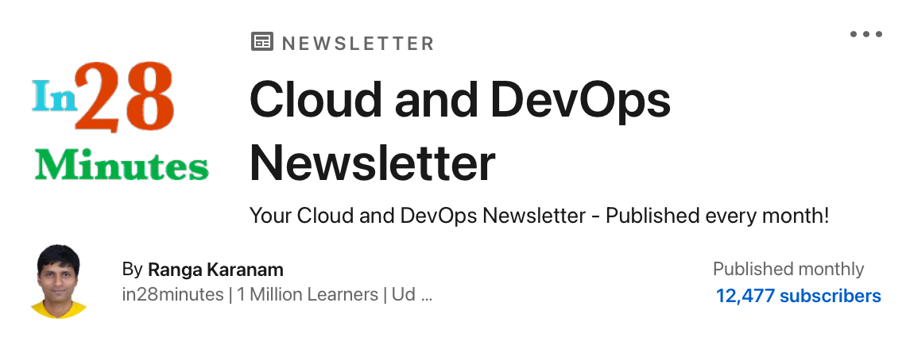

Slide 64






Platinum Partner
Gold Partner
Silver Partner

Slide 66
Why are Cloud Certifications Important?
Ranga Karanam
Founder – in28minutes
Presentation title
Dedicated to
Sathish Murugesan

